Slide 1
Zephyr for JIRA User Guide Test Cases
Author: Esthela Munguía

Slide 2
Topics
How to access to Jira and select a project
How to create Test Cases
How to Search & Edit Test Cases
Test Cycle Planning
Test Cases Execution from a Test Cycle
Defects Register and Follow Up
Dashboards
Information of projects

Slide 3
1. How to access to Jira and select a project

Slide 4
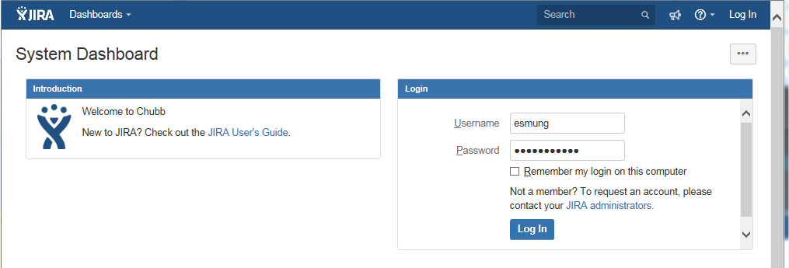
1. How to access to Jira and select a project
To access the Jira System it is necessary that the user enter the following link through Windows Explorer and capture the user name (LAN ID) and password and finally select the button <<Log In>>

Slide 5
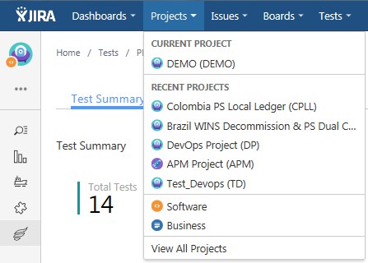
1. How to access to Jira and select a project
Before starting any test action, the user must ensure having the correct project to work. Option: Projects-> Current project
In this example we are working with Demo project:
Note: To review the project that you are going to work, please to see the section 8-Information of projects

Slide 6
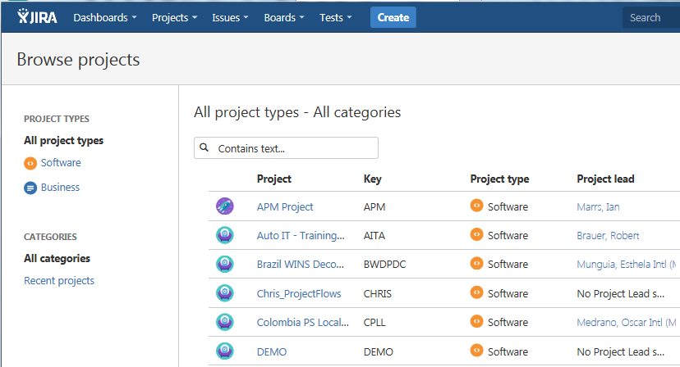
1. How to access to Jira and select a project
In case of having another project enabled, the user can select the correct project in the list. Option: Projects-> View All Projects.

Slide 7
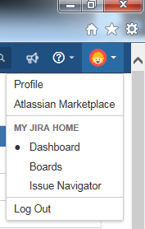
1. How to access to Jira and select a project
To exit the Jira application can be done as below:
Select the user profile and then the option <<Log out>> or
Close the windows explorer window.

Slide 8
2. How to create Test Cases

Slide 9
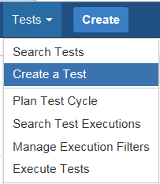
2. How to create Test Cases
To generate a new test case, the user needs to select the option: Tests->Create a test.
The system will display the capture of information where:
The capture data marked with the symbol (*) means that they are mandatory.
Other fields are not mandatories, but it is necessary to fill out the information and it is depend of the configuration of project, they are:
Labels (Statistics, No Statistics)
Component/s (MDM, SIS, TDS, SIAC, PCW Staging, PCW UK, PeopleSoft GL, PeopleSoft Informatica, A Fix Web, APD Payroll, etc.)
Fix Version/s (SIT, UAT)

Slide 10
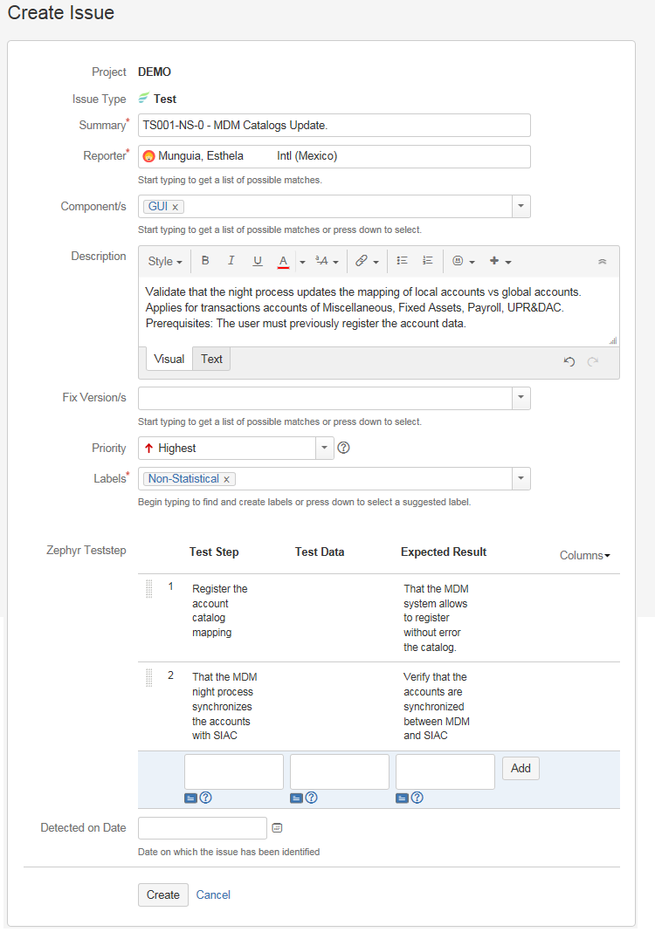
2. How to create Test Cases
In the details section, it can be specified the steps of the test case and the expected result.
At the end, when all the fields to create the test case are filled, the user must select the button <<Create>>.
For more information you can consult the link:
https://zephyrdocs.atlassian.net/wiki/spaces/ZFJ0300/pages/31653901/Create+Tests

Slide 11
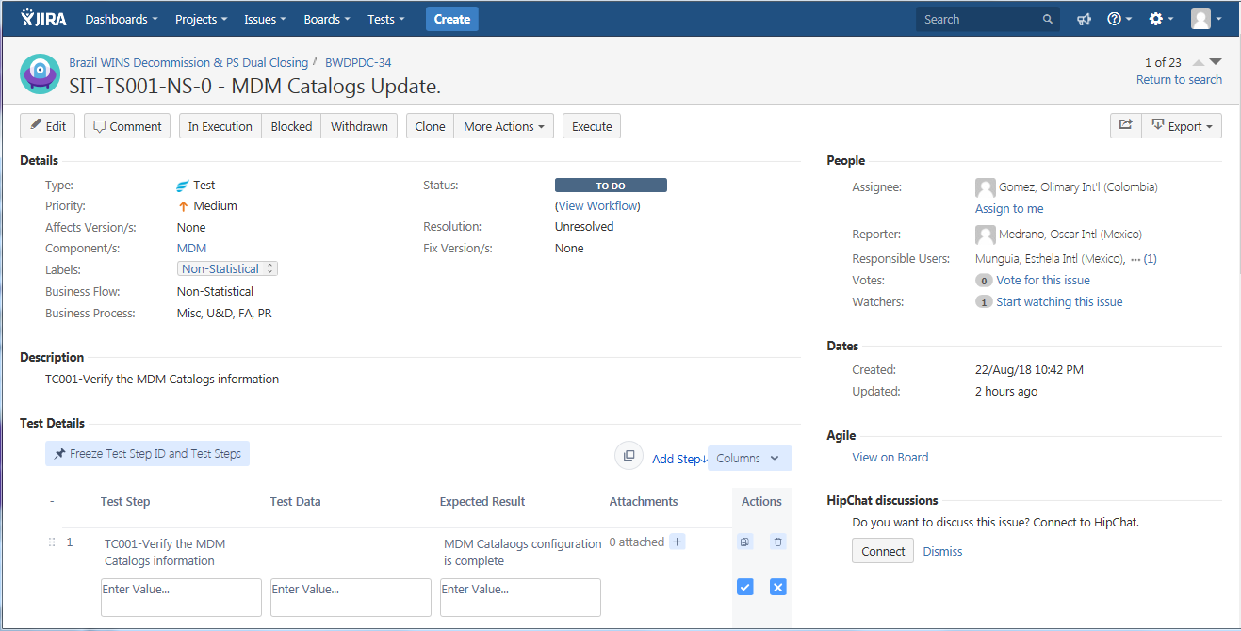
2. How to create Test Cases
Finally, the System registers the test case.
Note: There is an additional Jira tool that allows a massive upload of test cases.

Slide 12
3. How to Search & Edit Test Cases

Slide 13
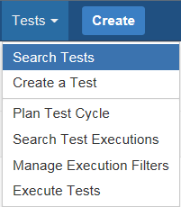
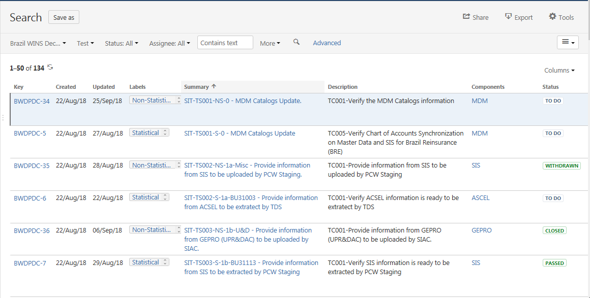
3. How to Search & Edit Test Cases
To find a test case, the user must select the option: Tests-> Search Tests.
The system will display the cases of tests of the current project.

Slide 14
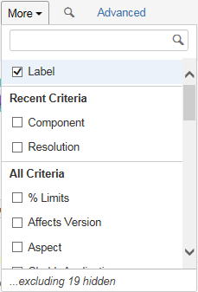
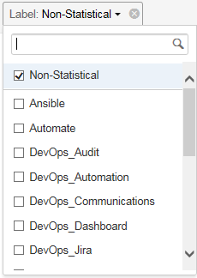
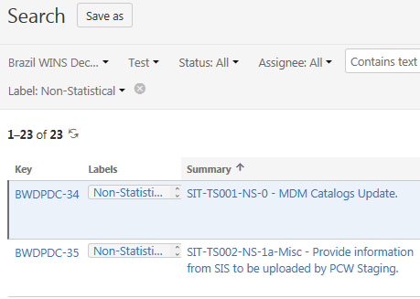
3. How to Search & Edit Test Cases
The user can select some basic search criteria for test cases by project, status and assignee.
Also the user can change the search criteria by selecting the button options <<More>> and then include another filters as below:

Slide 15
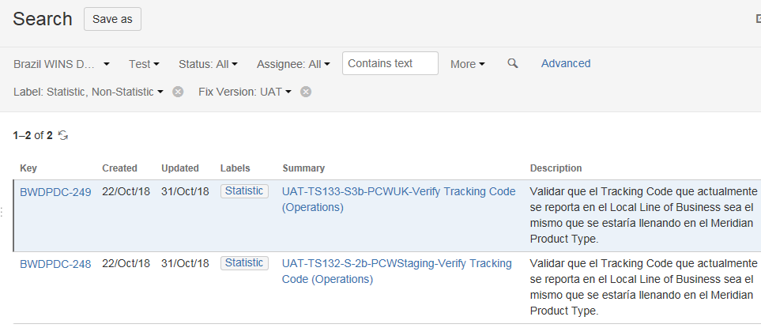
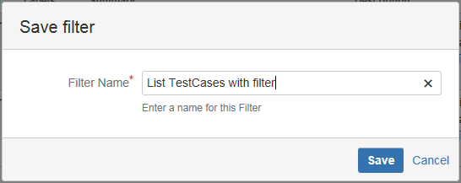
3. How to Search & Edit Test Cases
The list generated with the selected filters can be saved and used for queries or other options.
The user needs to select the <<Save as>> option, specify a name and finally select the <<Save>> button.

Slide 16
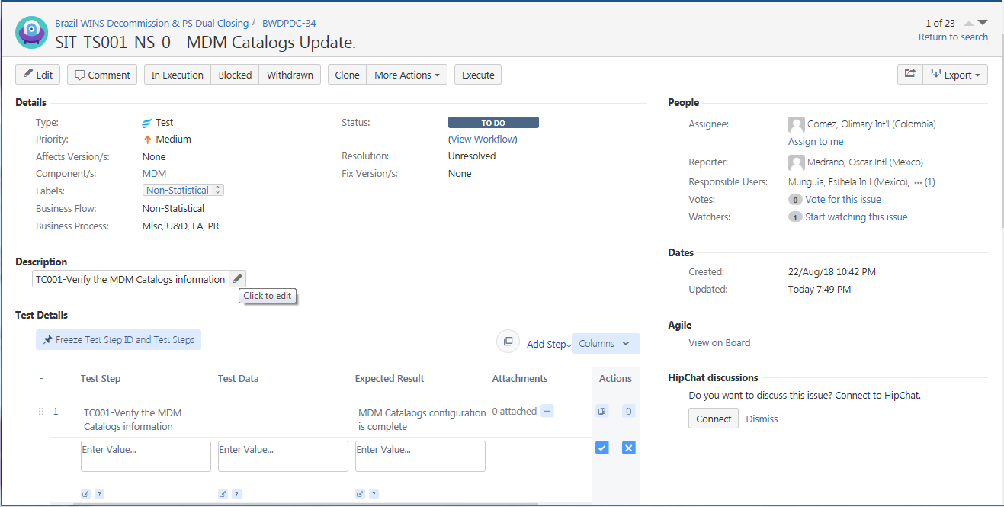
3. How to Search & Edit Test Cases
When the user selects the test case, the system will display the information in the screen, where the user can update a data directly or select the <<Edit>>.

Slide 17
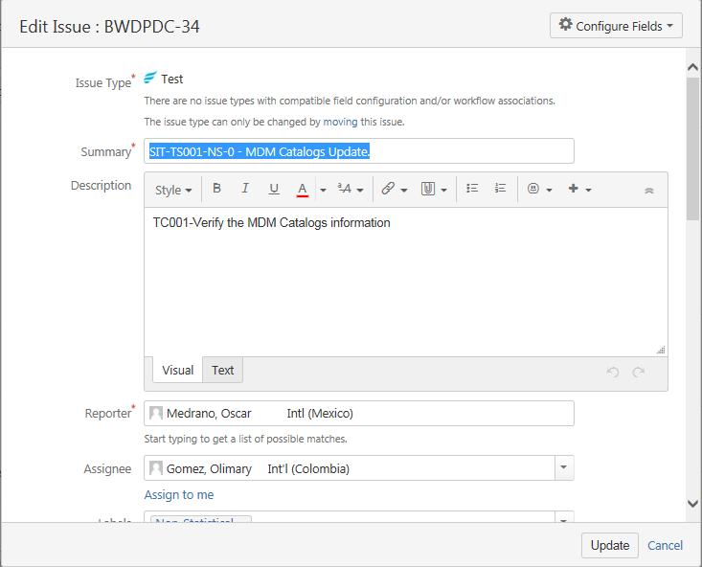
3. How to Search & Edit Test Cases
If the user selected the button <<Edit>> the system will display a new window and then the user can modify the information of test case and save the changes with button <<Update>>.

Slide 18
4. Test Cycle Planning

Slide 19
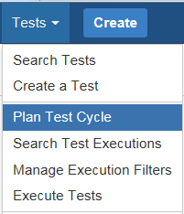
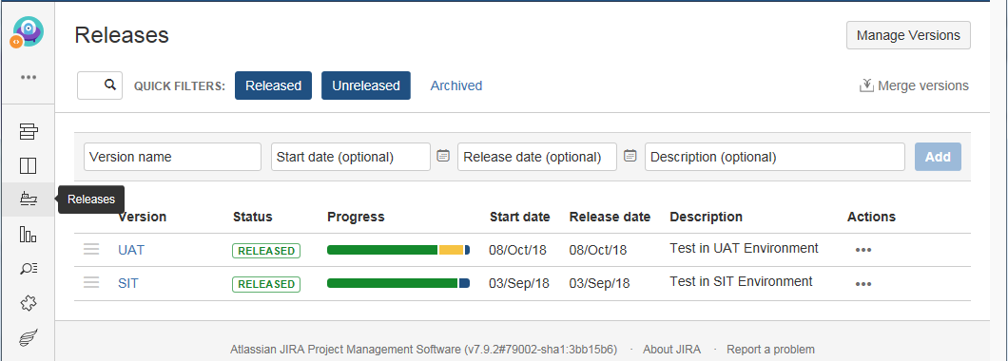
4. Test Cycle Planning
It must be validated that the UAT and SIT test types are registered in Jira.
Option: Plan Test Cycle -> Releases.

Slide 20
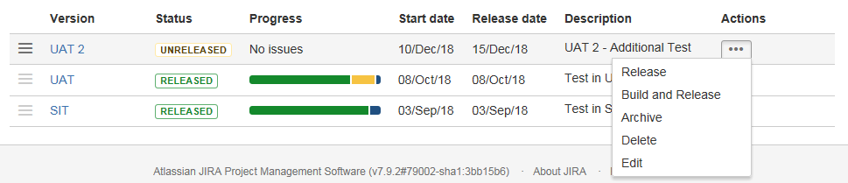
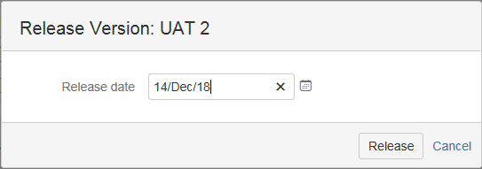
4. Test Cycle Planning
To create a new release, it is necessary to record the capture data and then select the <<Add>> button.
The system will display the new record in the list. Then you must select the action << ... >>, capture the date and select the <<Release>> button.

Slide 21
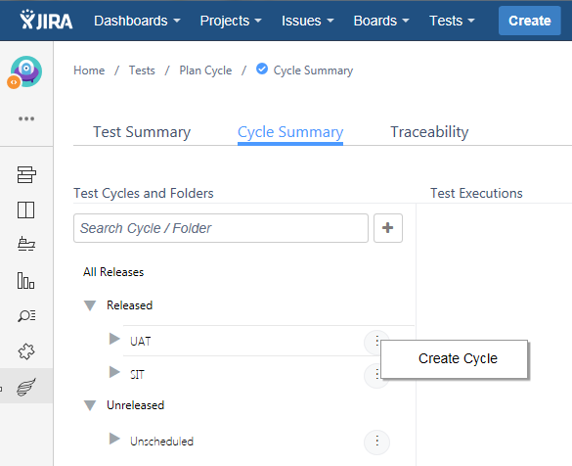
4. Test Cycle Planning
To create a new cycle you must select <<Create Cycle>>, in the tab Cycle Summary, option Test Cycles and Folders->All Releases->Released (UAT or SIT).

Slide 22
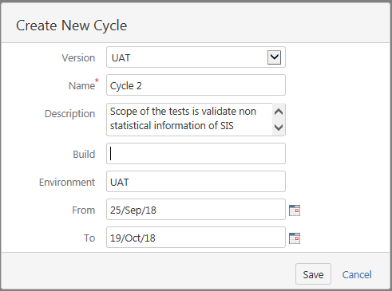
4. Test Cycle Planning
The user must capture the cycle data such as the scope and planned dates of execution of the tests, upon completion the user must select the << Save >> button.

Slide 23
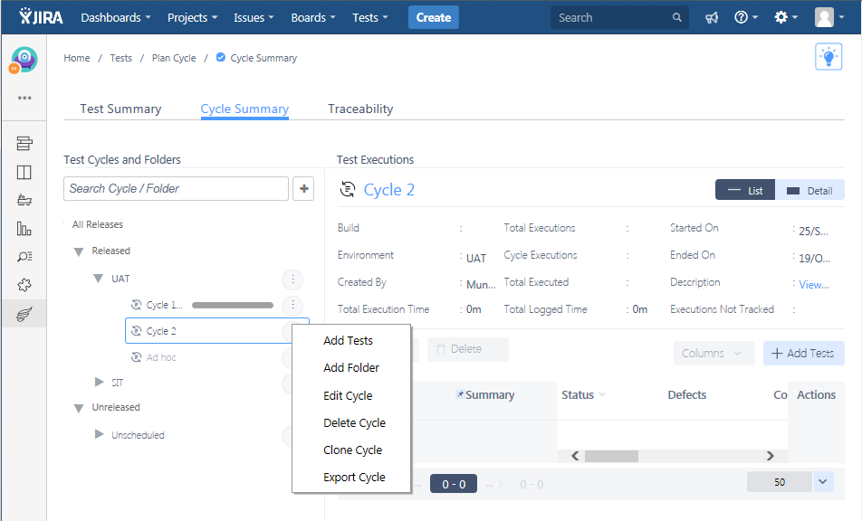
4. Test Cycle Planning
When the test cycle is created, the secondary mouse button on the cycle must be selected and the system will display the options such as adding test cases to the cycle.

Slide 24
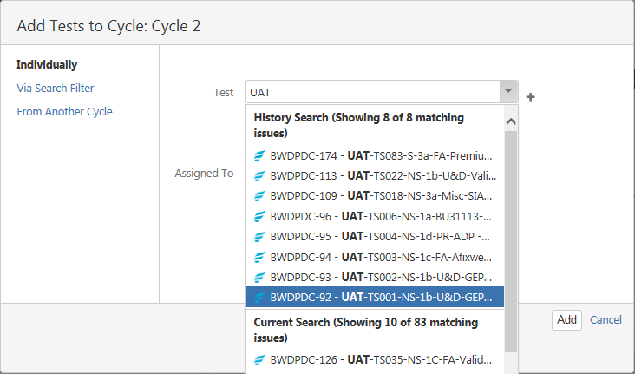
4. Test Cycle Planning
The test case (s) must be searched and assigned to the cycle, as well as the person responsible for executing them. Finally the <<Add>> button is selected.

Slide 25
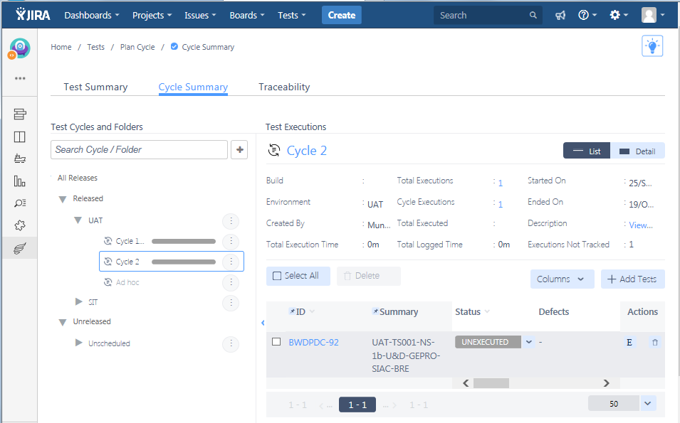
4. Test Cycle Planning
The test case was added to the cycle.

Slide 26
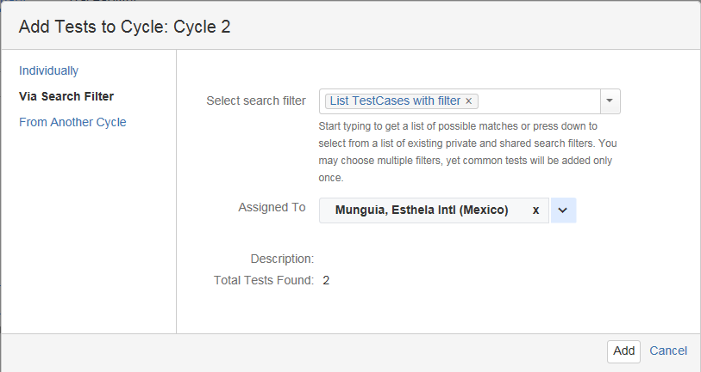
4. Test Cycle Planning
The other option that exists is to add or associate the test cases through a previously created query, in which there are several test cases grouped (See slide 15).

Slide 27
5. Test Cases Execution from a Test Cycle

Slide 28
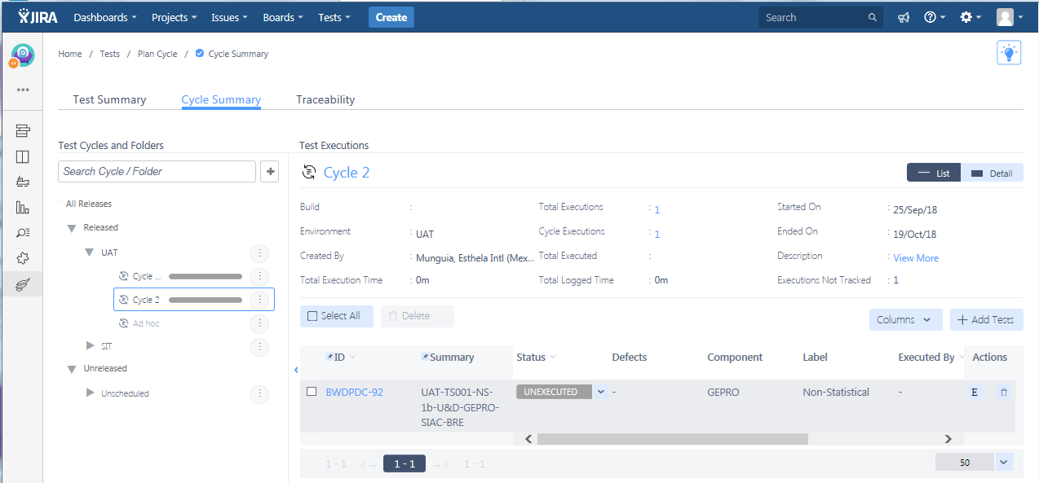
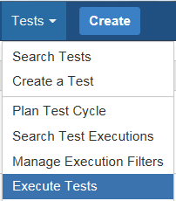
5. Test Cases Execution from a Test Cycle
To execute a test case, you must first look for the cycle to be processed in the option Test->Execute Tests, where the system will display the test cases associated with each cycle. Search the test case to execute and select the button <<E>>.

Slide 29
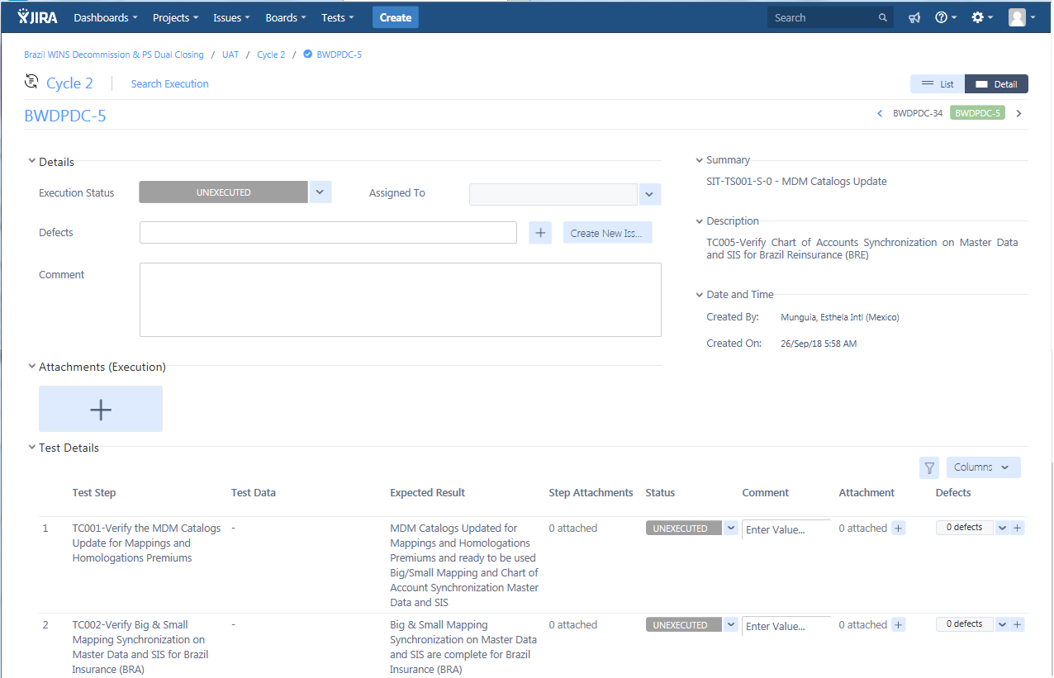
5. Test Cases Execution from a Test Cycle
Note: When running the test case, remember to attach the evidence.

Slide 30
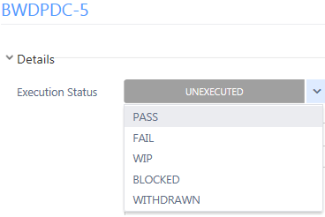
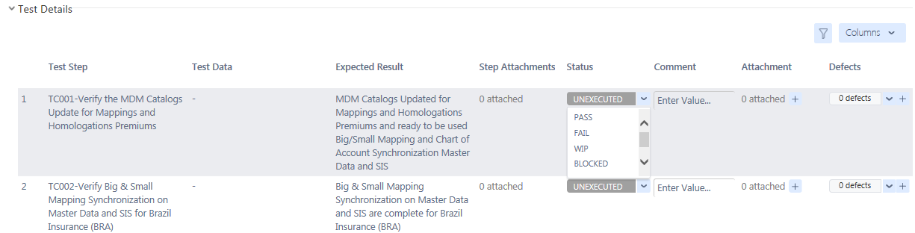
5. Test Cases Execution from a Test Cycle
If the steps of the test case are not defined, the field “Execution status” can be indicated at a general level based on the following options.
If the steps of the test case are defined, the user must change the status in each step.

Slide 31
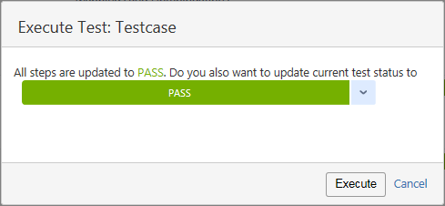
5. Test Cases Execution from a Test Cycle
If all steps are as "Pass", the system will display a window asking if you want to change the general status as "Pass“.

Slide 32
6. Defects Register and Follow Up

Slide 33
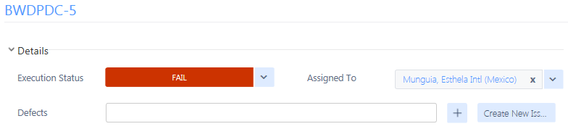
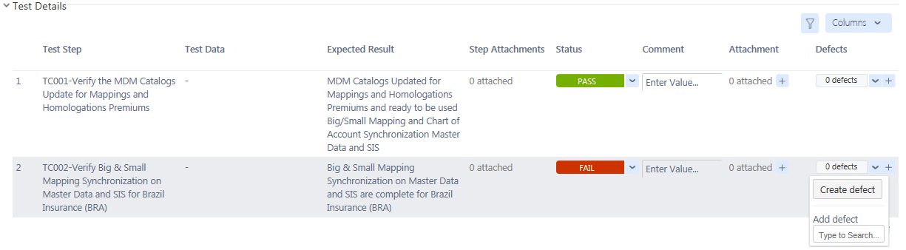
6. Defects Register and Follow Up – New error
If exist an error during the test execution, it can be created at a general level or within the steps of the test case, therefore it is necessary to indicate the status as “FAIL" and then select the button <<Create New Issue>> or <<Create defect>>.

Slide 34
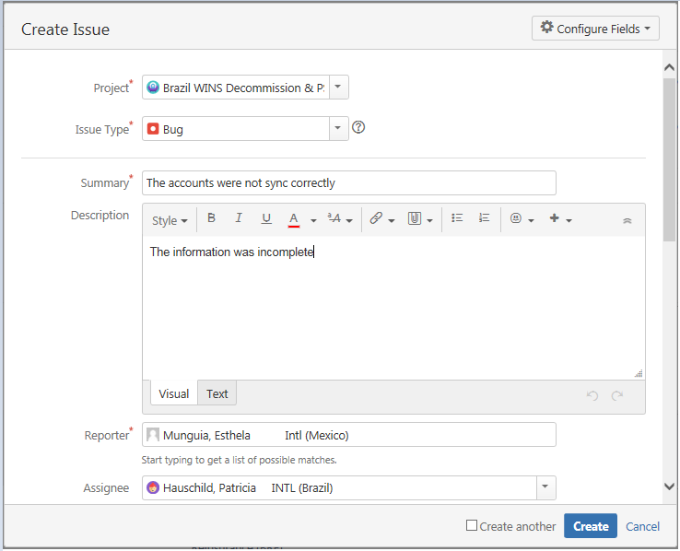
6. Defects Register and Follow Up – New error
The system will display a window where it is necessary to capture the data as Issue Type (Bug), Summary, Component (Systems), Description, Priority, Label (Statistical or Non-Statistical), Affects Version/s (SIT or UAT), Person to whom it is assigned, date in which the issue was detected. Finally, the user must select the << Create >> button.

Slide 35
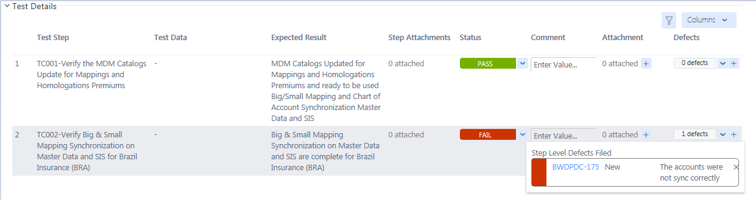
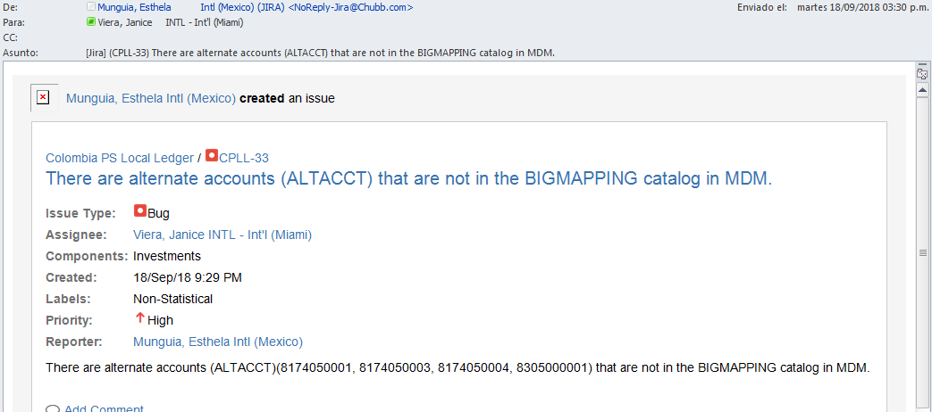
6. Defects Register and Follow Up – New error
The system will generate a consecutive number in the project and the defect will be associated to the test case. Also the system will send an email of the defect to the assigned person.

Slide 36
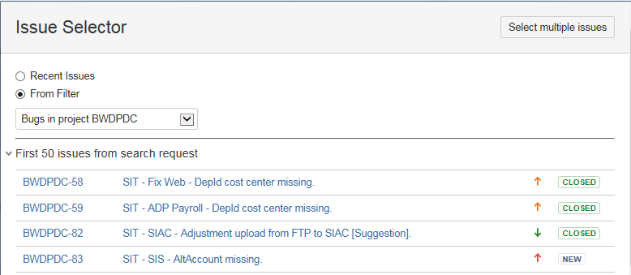
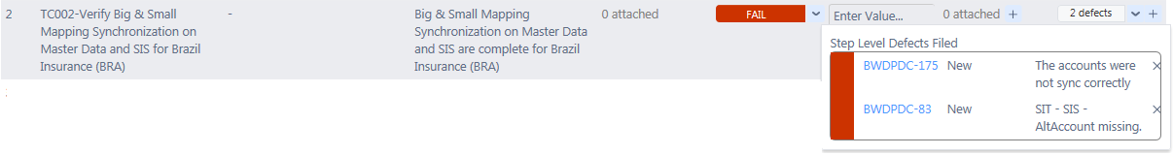
6. Defects Register and Follow Up – Existing error
In case the error already exists in Jira, it must be searched and associated to the test case by selecting the sum button <<+>>. The system will display a screen to search and select the error. (In this example the error 83 was selected).
Note: If users are assigned to different projects they can select the project with the <<From Filter>> option

Slide 37
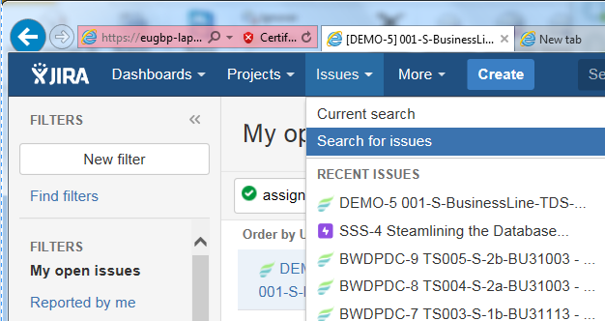
6. Defects Register and Follow Up – Consult the errors
Subsequently, the user can review the errors generated in the “Issues-> Search for issues” option.
The system will display different search filters, but they include all kind of movements in Jira (Epic, Task, Test and Bug):
My open issues - These are movements assigned to me.
Reported by me - These are movements registered by me.

Slide 38
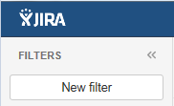
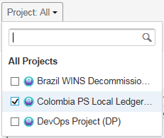
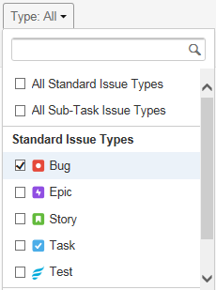
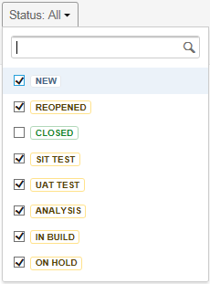
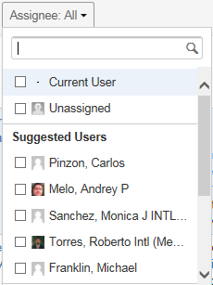
6. Defects Register and Follow Up – Consult the errors
To check registered errors, the user can create a query to filter
the information, as below:
Select the option Filters->New Filter.
The system will display all information.
The user can modify the filters as Project, Type (this must be BUG), Status and Assignee. Also can select the button <<More>> to select additional filters.

Slide 39

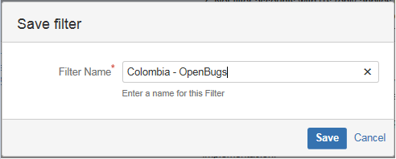
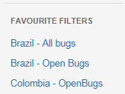
6. Defects Register and Follow Up – Consult the errors
When the filters are correct, the user can select the option <<Save As>> and then capture a name of filter.
The system will add it in the Favorite Filters section, and it will be available for use as many times as necessary.
Note: Remember to configure the filters in a Basic way and not in Advanced

Slide 40
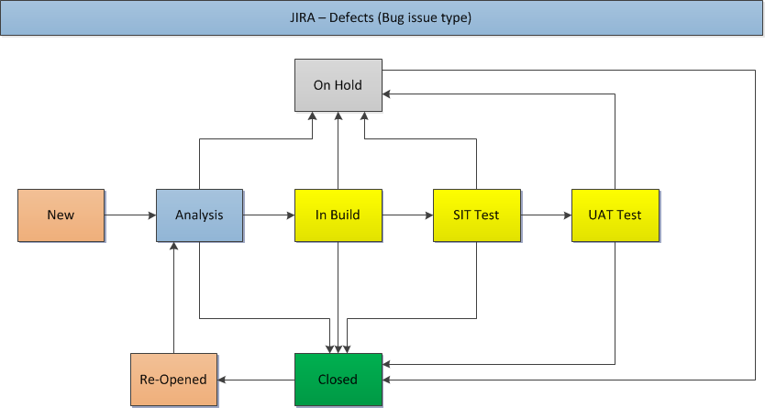
6. Defects Register and Follow Up – Update the error
To update and close the error we have different status. When a error is created the first status is “New”.

Slide 41
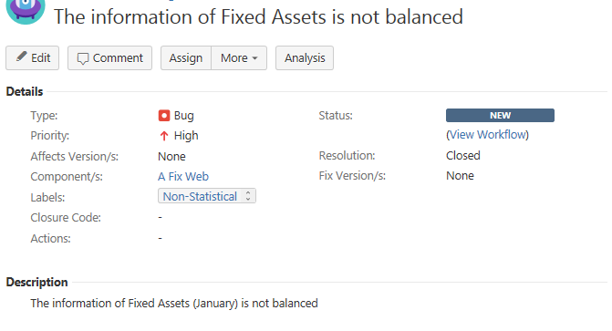
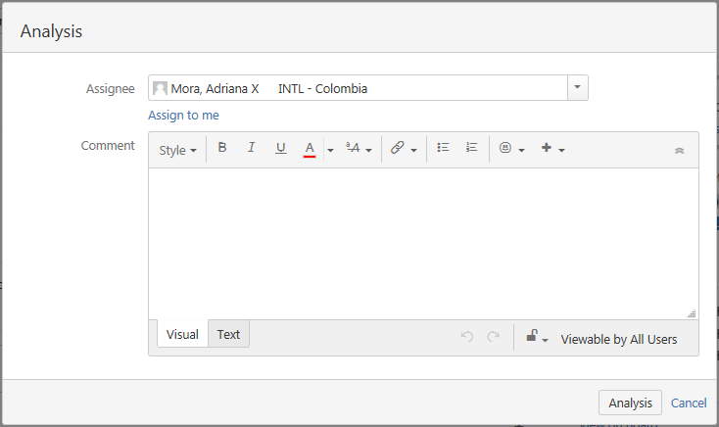
6. Defects Register and Follow Up – Update the error
When the user enters to review a new error, the user can select the <<Analysis>> button and then capture a comment.

Slide 42

6. Defects Register and Follow Up – Update the error
The system will change the error status and the options will be opened:
In Build
On Hold
Closed

Slide 43


6. Defects Register and Follow Up – Update the error
If the person makes the corrections to the error, it should select the option <<Closed>>, the system will display a screen to attach the comments or evidence finally select the option <<Closed>> again. The system will close the error.
If the error requires code development or programming, then the <<In build>> option must be selected and then the test phases and finally <<Closed>>.
If the error should be corrected in the following cycles, the <<On hold>> option must be selected.

Slide 44

6. Defects Register and Follow Up – Update the error
In each update in the error, the user who reported the error will be informed by mail.
If the error is closed, the user can continue with their validations and close the test cases as “PASS”.

Slide 45
7. Dashboards

Slide 46



7. Dashboard
To obtain a report on the tests, the user can create a Dashboard in the option <<Manage Dashboard->Create new dashboard>>.
It is necessary to indicate the Name, Description, Start From (another Dashboard. For example: Zephyr Dashboard) and the people that the report will be shared.

Slide 47


7. Dashboard
For sharing options, the user can select one or several people or groups with the Button << + Add >>
When the user registers all the data and selects the << Add >> button, the new dashboard will appear in the list.

Slide 48



7. Dashboard
When selecting the new Dashboard, the system will display 2 test reports.
1) The user can erase the report:
“je.gadget.testcase.creation.title”
2) And configure the parameters of the report “je.gadget.testcase.execution.title”, as below:
The result of the report is:

Slide 49


7. Dashboard
3) Is necessary that the user add a new reports. Button <<Add gadget->Load all gadgets>>
Twice

Slide 50


7. Dashboard
4) Configure the parameters of the report “je.gadget.testcase.execution.status. title” as Tabular Chart, as below:
The result of the report is:

Slide 51


7. Dashboard
5) Configure the parameters of the report “je.gadget.testcase.execution.status. title” as Pie Chart, as below:
The result of the report is:

Slide 52


7. Dashboard
6) Configure the parameters of the report “je.gadget.testcase.execution.title” by component (system), as below:
The result of the report is:

Slide 53


7. Dashboard
7) Configure the parameters of the report “je.gadget.testcase.execution.cycle. status.title”, as below:
The result of the report is:

Slide 54

7. Dashboard
Each time the information of the test cases is updated, it will be reflected automatically in the Dashboard graphs.

Slide 55
8. Information of projects

Slide 56
8. Information of projects
The access in Jira is:
https://jira-eugb-prod.chubb.com/

